Slide 1
Machine Vision MCT 4323/ MCTE 4323
Dr. Hasan Firdaus Bin Mohd Zaki
Lecture 11: Transfer Learning & Domain Adaptation

Slide 2
Transfer Learning
The ability to apply knowledge learned in previous tasks to novel tasks
Based on human learning, people can often transfer knowledge learned previously to novel situations
Play classic piano 🡪 Play jazz piano
Ride Motorbike 🡪 Drive a car
Play soccer 🡪 play futsal
Math 🡪 Machine Learning

Slide 3
Traditional ML
Transfer Learning
Isolated, single task learning
Knowledge is not retained or accumulated. Learning is performed w/o considering past learned knowledge in other tasks
Learning of new tasks built upon the previous learned tasks
Learning process can be faster, more accurate and/ or need less training data
Learning task 1
Dataset 1
Learning task 1
Dataset 1
knowledge
Dataset 2
Learning task 2
Dataset 2
Learning task 2

Slide 4
Transfer learning in DL
Myth: You can’t do deep learning unless you have a million labelled examples for your problem
Reality
You can learn useful representations from unlabeled data
You can train on a nearby surrogate objective for which it is easy to generate labels
You can transfer learned representations from a related task

Slide 5
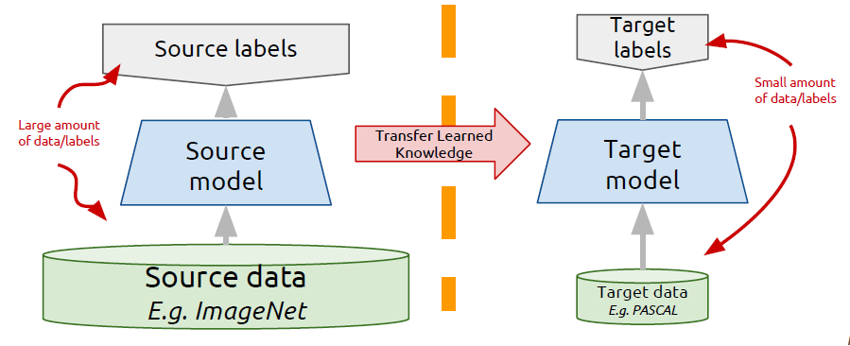
Transfer learning: idea
Instead of training a deep network from scratch for your task,
Take a network trained on a different domain for a different source task
Adapt it for your domain and your target task
Variations:
Same domain, different task
Different domain, same task

Slide 6
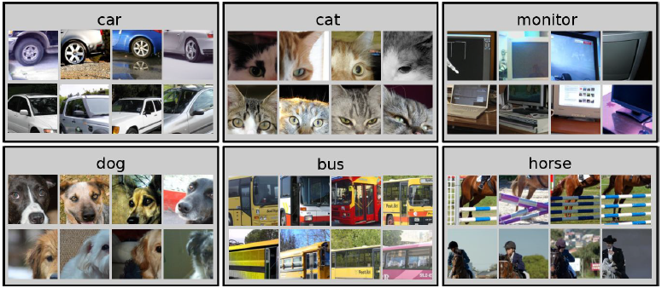
Example: PASCAL VOC 2007
Standard classification benchmark, 20 classes, ~10K images, 50% train, 50% test
Deep networks can have many parameters to learn (e.g. 60M in Alexnet)
Direct training (from scratch) using only 5K training images can be problematic 🡪 model overfitting
How can we use deep networks in this setting?

Slide 7
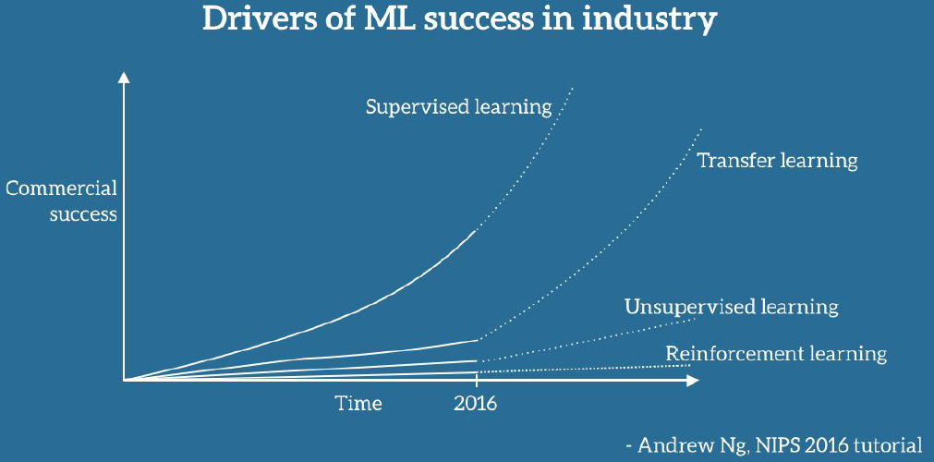
Transfer Learning

Slide 8
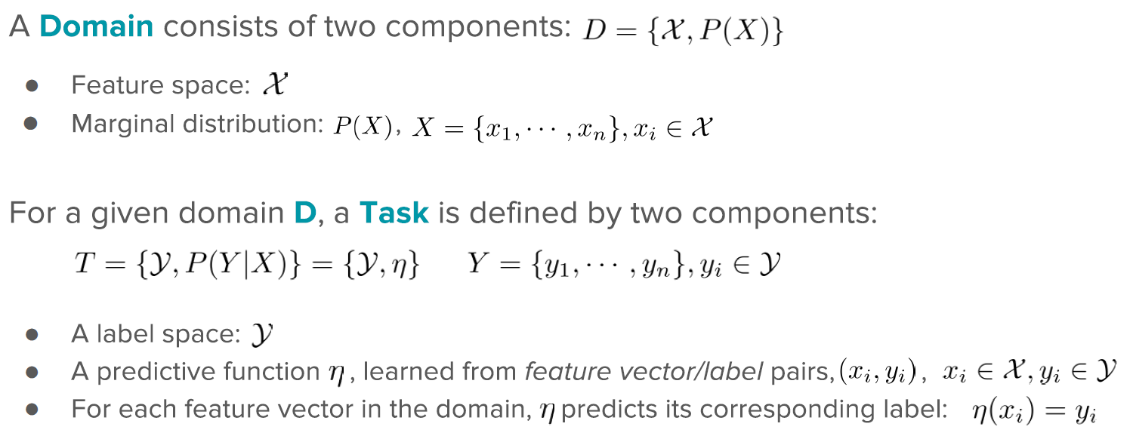
Notation (I)

Slide 9
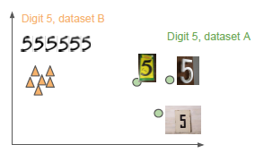
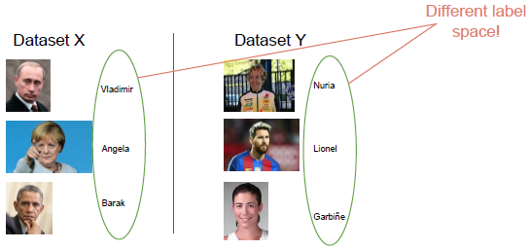
Notation (II)
If two domains are different, they may have different feature spaces or different marginal distributions
If two tasks are different, they may have different label spaces or different conditional distributions

Slide 10
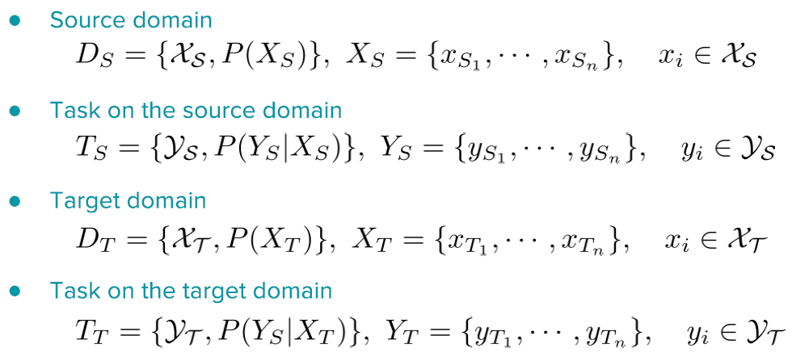
Notation (III)
For simplicity, only two domains or two tasks are usually considered

Slide 11
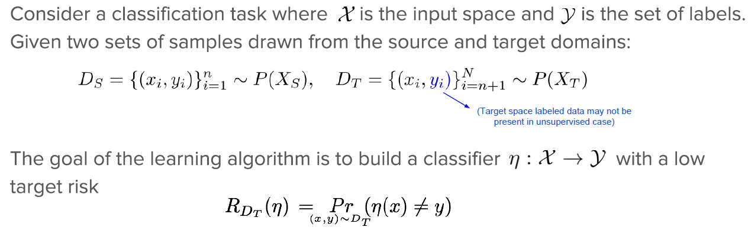
Domain Adaptation

Slide 12
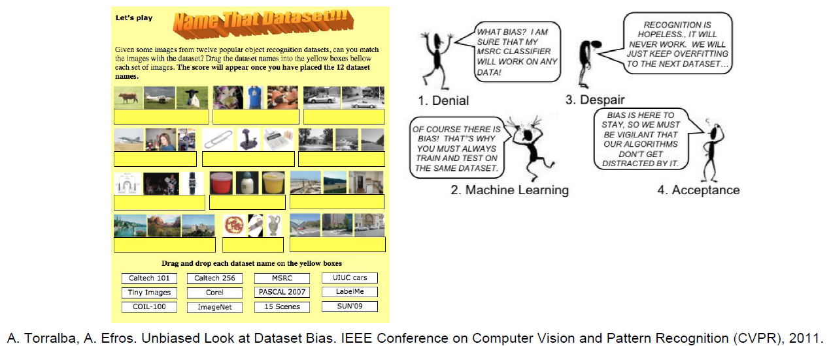
Domain Biases
Datasets are samples of the world
In many cases, there is a shift or bias in the distributions of the source and target data representations

Slide 13
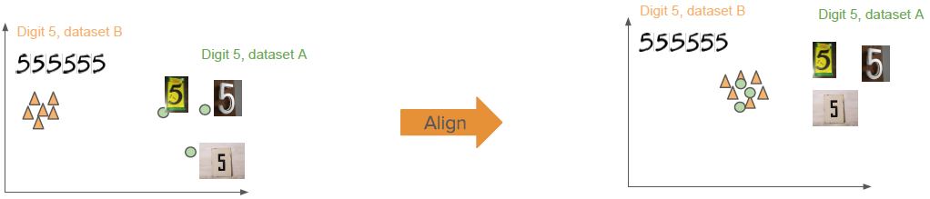
Domain Adaptation
When there is a domain shift
The size of this shift is often measured by the distance between source and target subspaces
A typical approach is to learn a feature space transformation to align the source and target representations (reduce domain divergence)

Slide 14
Domain Adaptation
When there is a domain shift
The size of this shift is often measured by the distance between source and target subspaces
A typical approach is to learn a feature space transformation to align the source and target representations (reduce domain divergence)

Slide 15
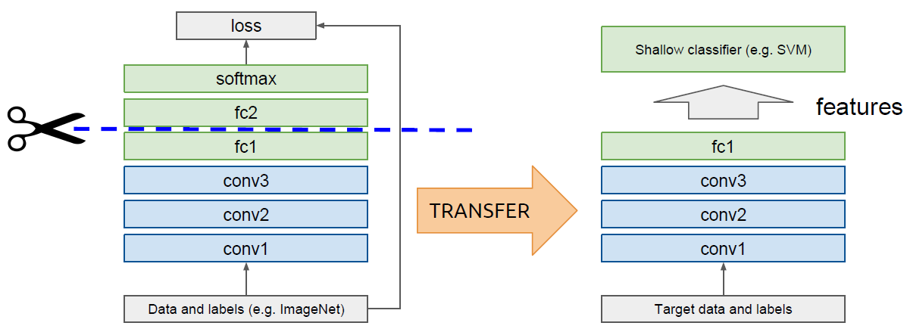
Domain adaptation using “off-the-shelf” CNN
Idea: use outputs of one or more layers of a network trained on a different task as generic feature detectors. Train a new shallow model on these features.
Assumes that DS ≈ DT

Slide 16
Domain adaptation using “off-the-shelf” CNN
Idea: use outputs of one or more layers of a network trained on a different task as generic feature detectors. Train a new shallow model on these features.
Assumes that DS ≈ DT

Slide 17
Domain adaptation using “off-the-shelf” CNN
Works surprisingly well in practice!
Surpasses or on par with state-of-the-art in several tasks in 2014
Image classification:
PASCAL VOC 2007
Oxford flowers
CUB Bird dataset
MIT indoors
Image retrieval:
Parik 6k
Holidays
UKBench
Razavian et al, CNN Features off-the-shelf: an Astounding Baseline for Recognition, CVPRW 2014 http://arxiv.org/abs/1403.6382

Slide 18
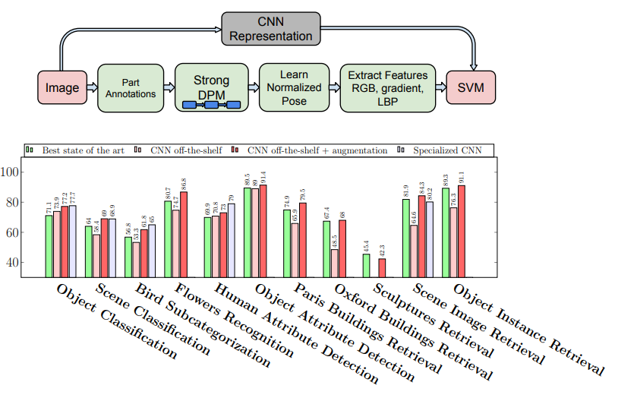
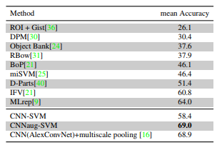
Domain adaptation using “off-the-shelf” CNN
Razavian et al, CNN Features off-the-shelf: an Astounding Baseline for Recognition, CVPRW 2014 http://arxiv.org/abs/1403.6382

Slide 19
Domain adaptation using “off-the-shelf” CNN
Razavian et al, CNN Features off-the-shelf: an Astounding Baseline for Recognition, CVPRW 2014 http://arxiv.org/abs/1403.6382

Slide 20
Can we do better than off-the-shelf features?

Slide 21
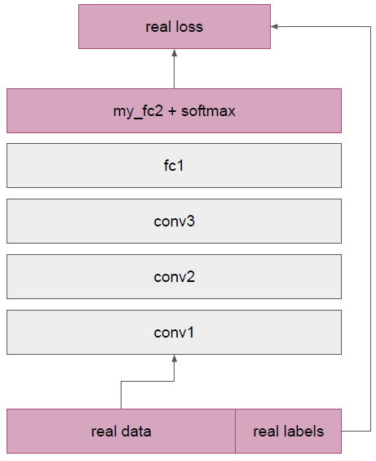
Fine-tuning: supervised domain adaptation
Train deep net on “nearby” task for which it is easy to get labels using standard gradient descent + backprop
ImageNet classification
Pseudo classes from synthetic data
Cut off top layer(s) of network and replace with supervised objective for target domain
Fine-tune network using backprop with labels for target domain until validation loss is minimized
Align D_{S} with D_{T}

Slide 22
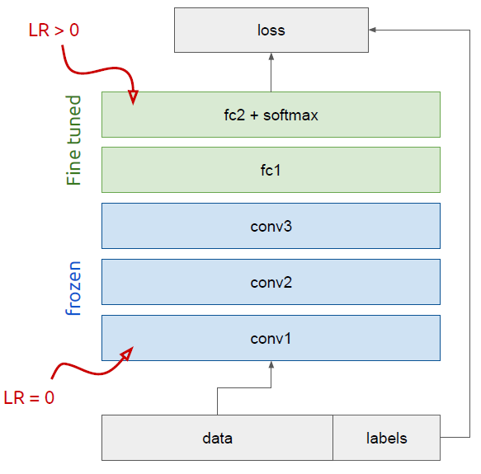
Freeze or fine-tune?
Bottom n layers can be frozen or fine-tuned
Frozen: not updated during backprop
Fine-tuned: updated during backprop
Which to do depends on target task
Freeze: target task labels are scarce and we cant to avoid overfitting
Fine-tune: target task labels are more plentiful
In general, we can set learning rates to be different for each layer to find a tradeoff between freezing and fine-tuning

Slide 23
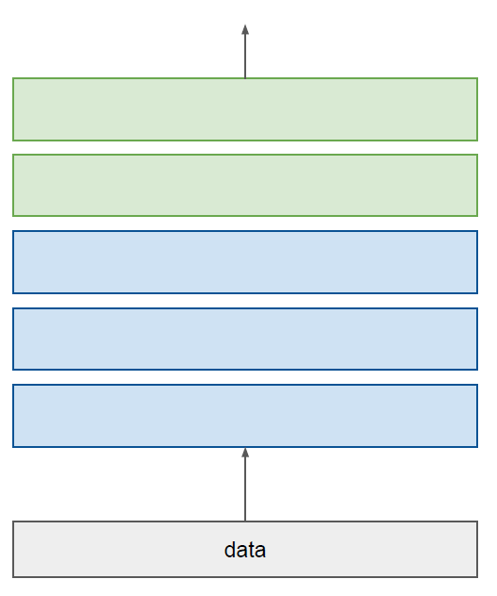
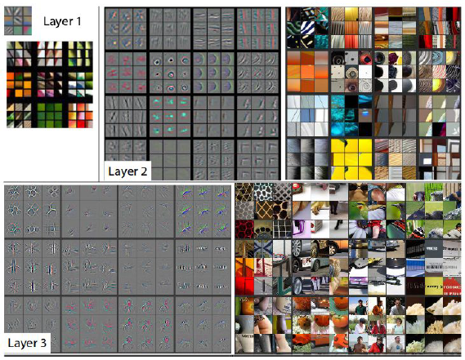
How transferable are features?
Lower layers: more general features. Transfer very well to other tasks.
Higher layers: more task specific (more semantically meaningful)
label
Matthew Zeiler, Rob Fergus, “Visualizing and Understanding Convolutional Networks”, CVPR 2013

Slide 24
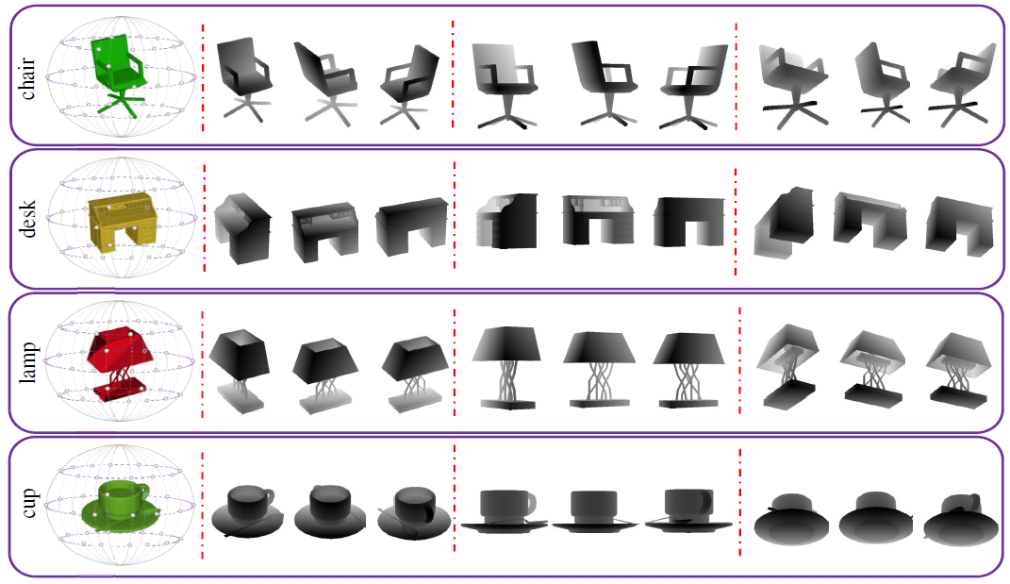
Learning from Synthetic Data
Learning from synthetic depth images for 3D object recognition
H.F.M. Zaki, F. Shafait, A. Mian, “Viewpoint invariant semantic object and scene categorization with RGB-D sensors ”,
Autonomous Robots 2018

Slide 25
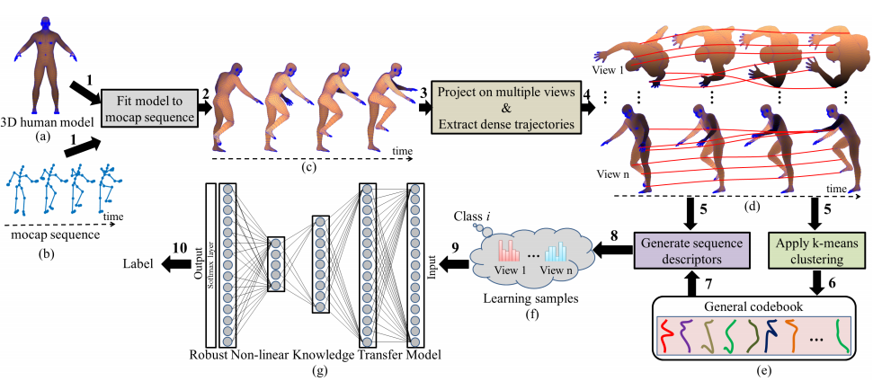
Learning from Synthetic Data
Learning from 3D human model for multi-view action recognition
H. Rahmani, A. Mian, M. Shah, “Learning a Deep Model for Human Action Recognition from Novel Viewpoints ”, PAMI 2017

Slide 26
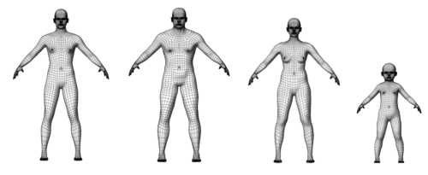
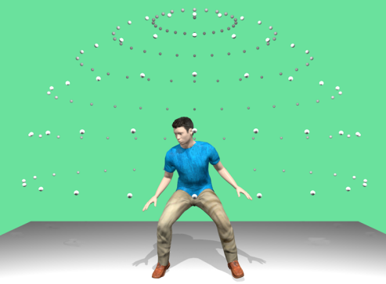
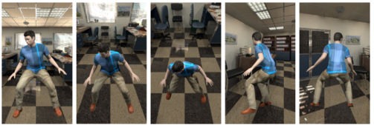
Learning from Synthetic Data
Learning from 3D human model for multi-view action recognition
J. Liu, H. Rahmani, N. Akhtar, A. Mian, “Learning Human Pose Models from Synthesized Data for Robust RGB-D Action Recognition”,
https://arxiv.org/pdf/1707.00823.pdf

